Slide 1


Microsoft Data Engineer
Final Project
End-To-End Data Pipeline
Microsoft Data Engineer

Slide 2




Microsoft Data Engineer
Meet The Team
Ibrahim
Mahmoud
Abdallah
Abdelrahman
DATA ENGINEER
DATA ENGINEER
TEAM LEADER
DATA ENGINEER

Slide 3





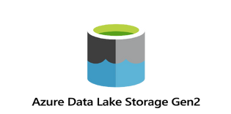

Microsoft Data Engineer
Overview:
Azure data factory
clean
&
transform
transformed data
Stage
SQL Pool
DWH
Data
Ingestion
data source

Slide 4
Microsoft Data Engineer
Key Steps:
1. Designing Database
2. Data Ingestion From On-Premises SQL Server
3. Data Cleansing and Transformation in Databricks
4. Designing Data Warehouse
5. Data Loading to Azure Synapse
6. Data Reporting in Power Bi

Slide 5
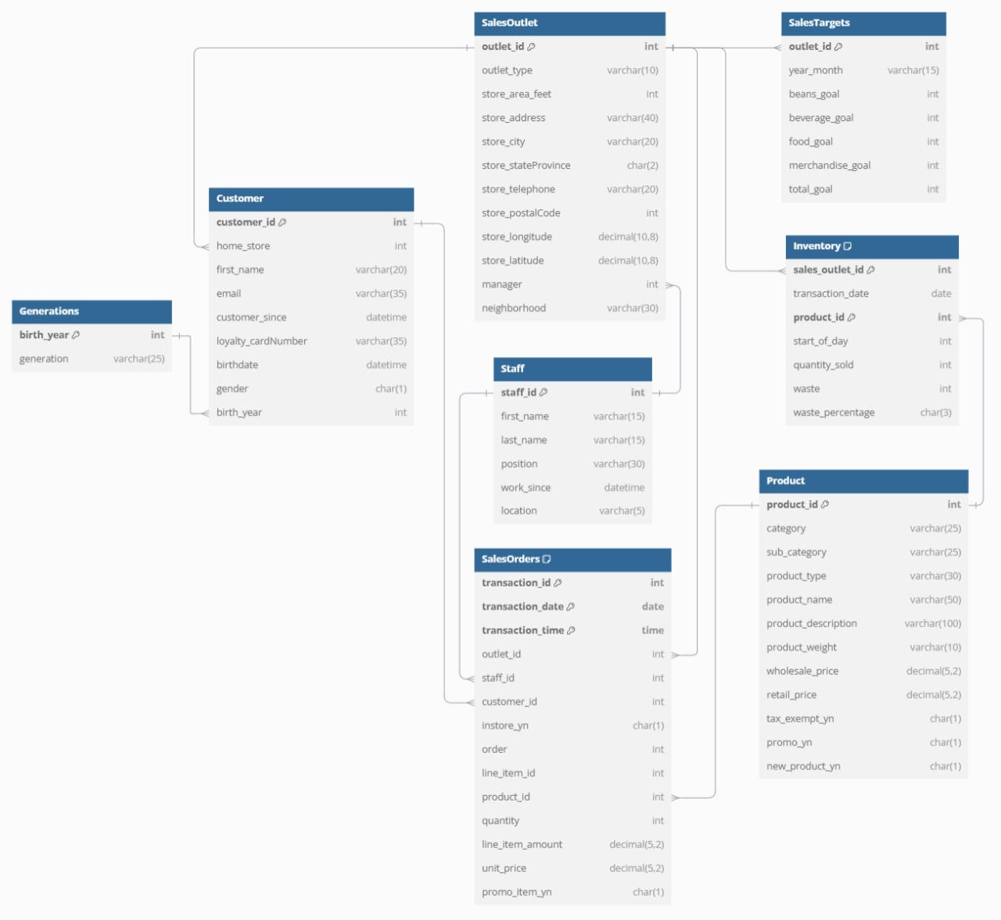

1. Designing Database
Initially, we designed the database schema for a coffee shop business, capturing data on stores, sales, customers, and products.

Slide 6
2. Data Ingestion From On-Premises SQL Server:
Data Ingestion to Azure Data Lake Gen2:
Data was extracted from the on-premise database and loaded into Azure Data Lake Storage Gen2 using Python’s libraries such pandas, pyodbc and azure.storage.blob . This provided a robust, scalable storage solution for raw data.

Slide 7

3. Data Cleansing and Transformation in Databricks
Databricks
Azure Databricks was utilized for data cleaning and transformation. The data was processed in two transformation layers :
.
Raw Layer (bronze): Stores unprocessed, raw data from the source systems.
Transformed Layers (silver and gold): Cleaned and normalized data ready for analytics and reporting.
.
.
All layers were stored in Azure Data Lake Gen2.

Slide 8
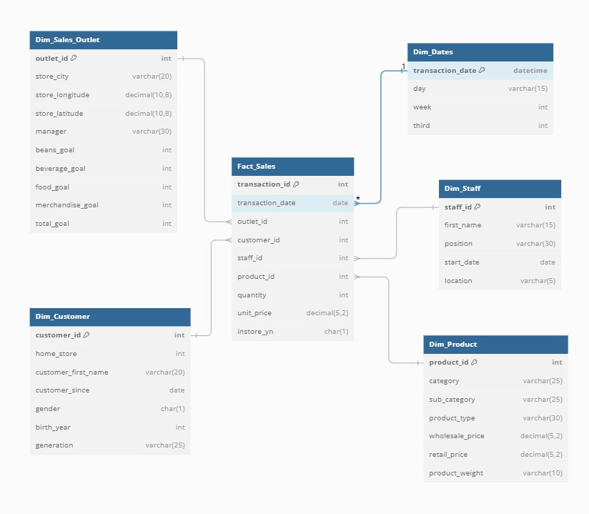
4. Designing Data Warehouse

Slide 9
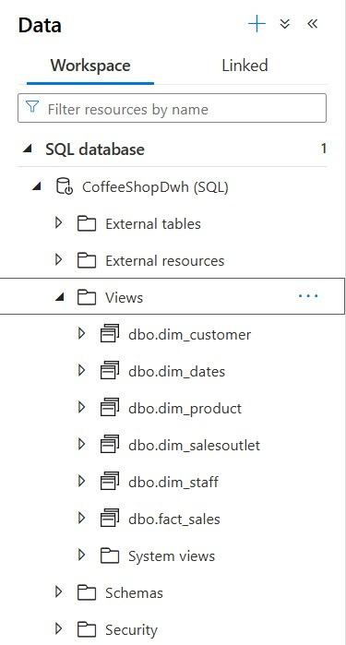
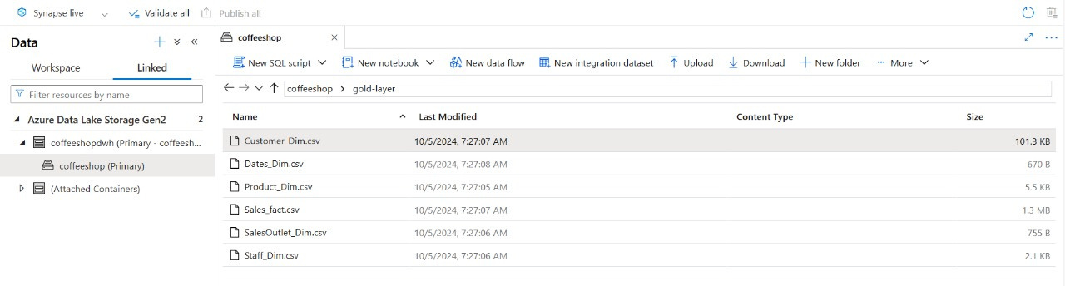
5. Data Loading to Azure Synapse
SQL Pool (Data Warehouse) Design on Azure Synapse:
.
After transformation, the cleaned data was loaded into a Data Warehouse designed using Azure Synapse Analytics (serverless) from gold layer .
The data warehouse allowed for efficient querying and analytics using SQL on-demand.
.

Slide 10
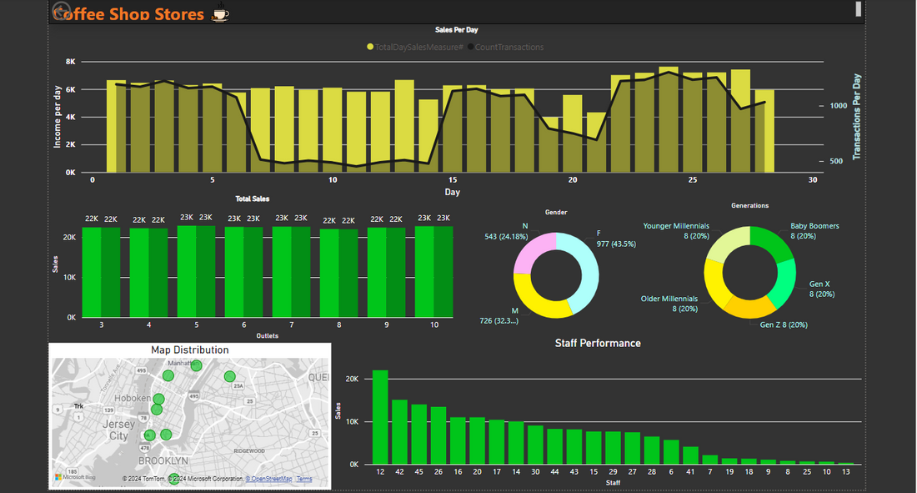
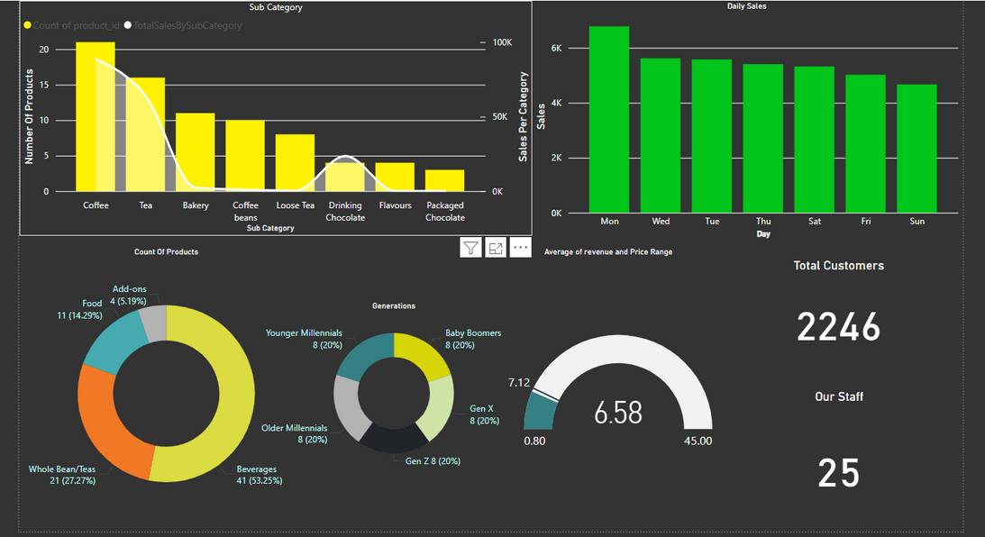
6. Data Reporting in Power Bi

Slide 11



Thank You
FOR YOUR ATTENTION

